Slide 1
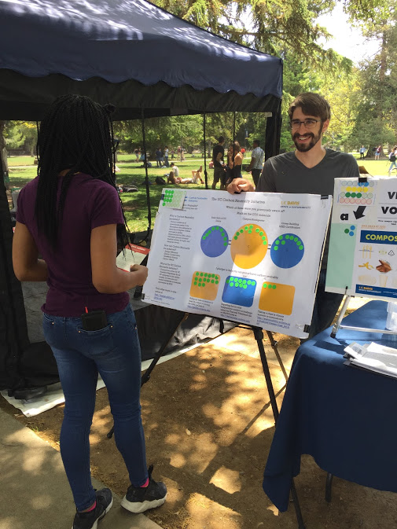
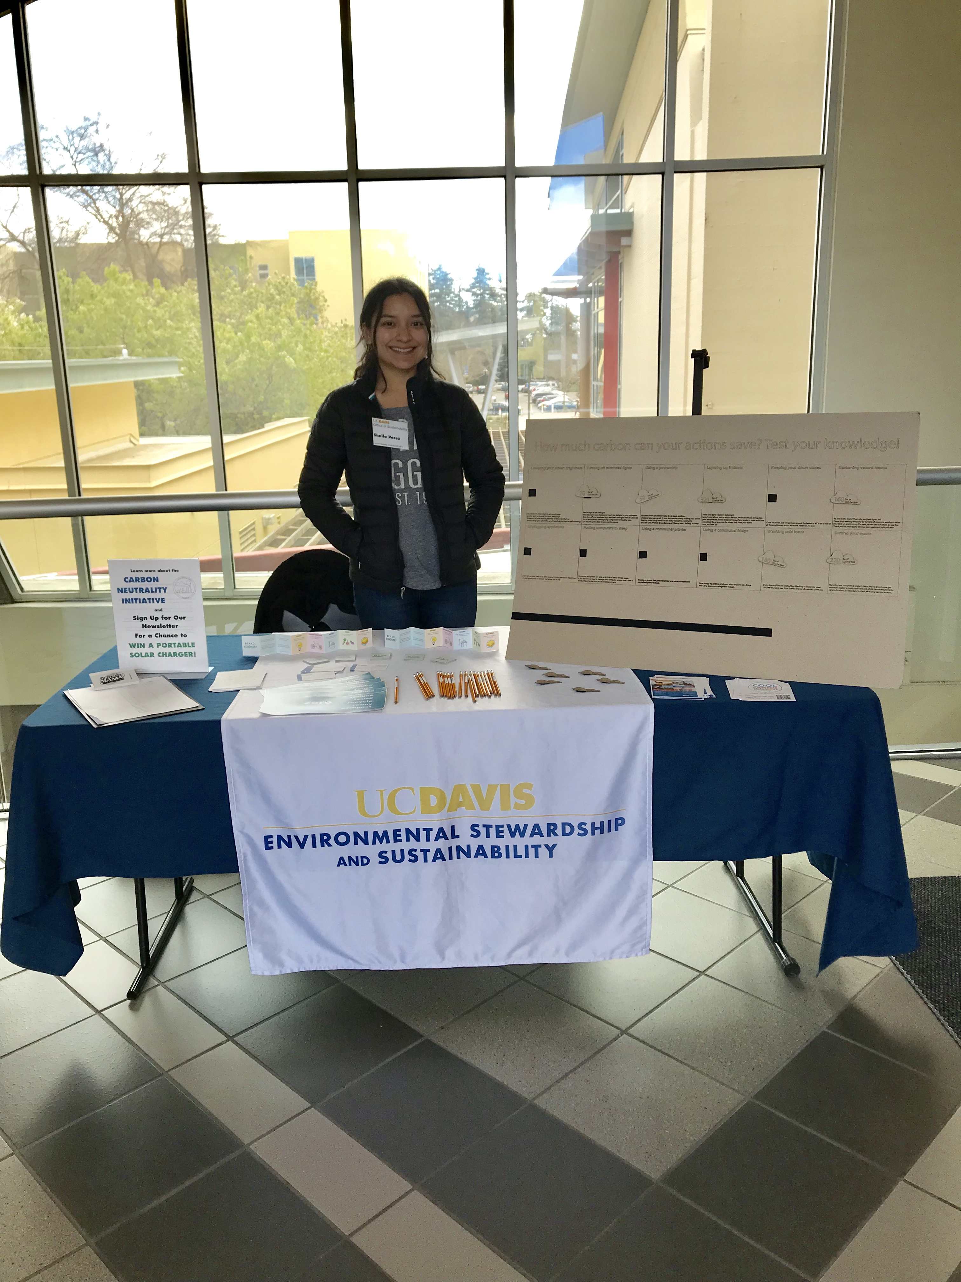
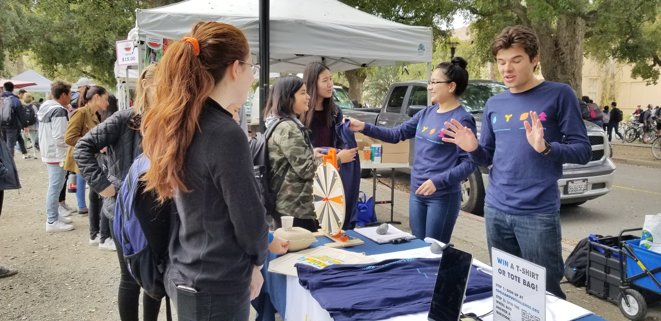
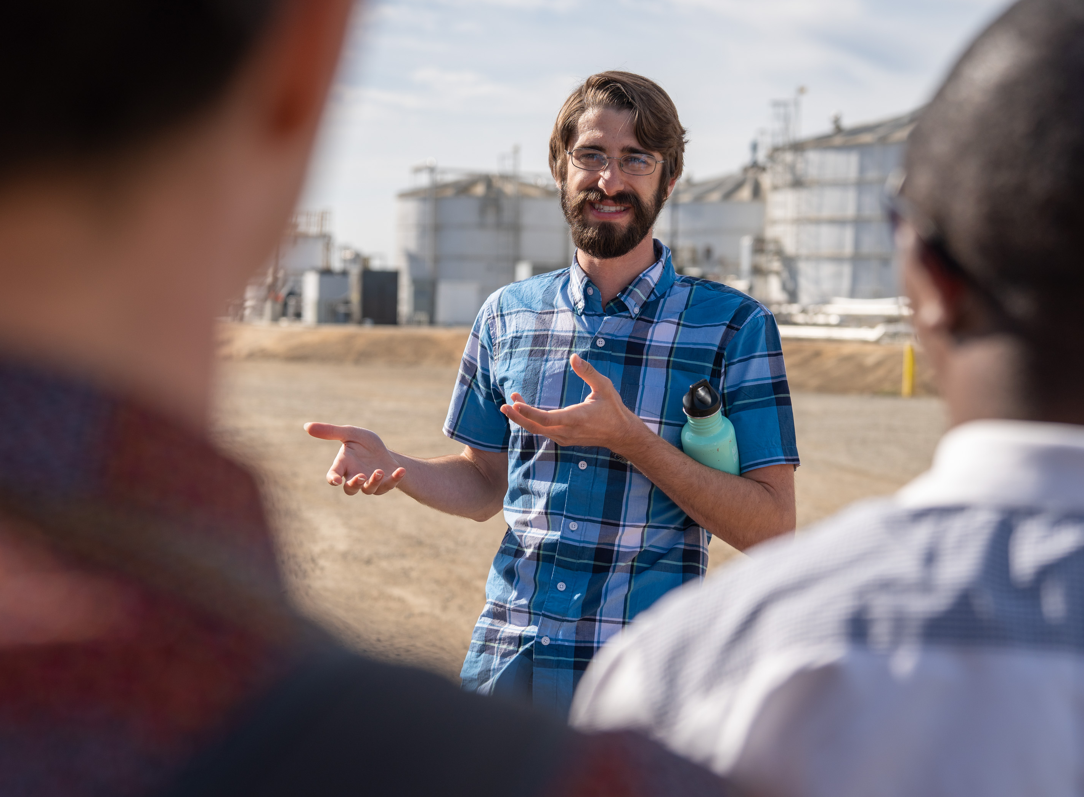
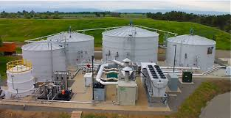
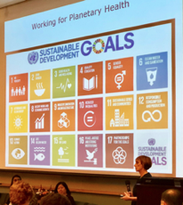
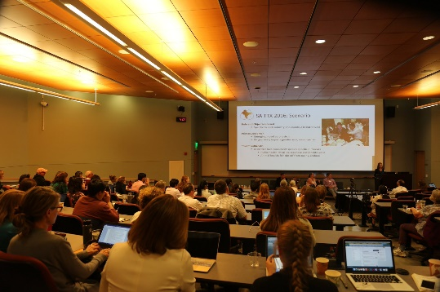
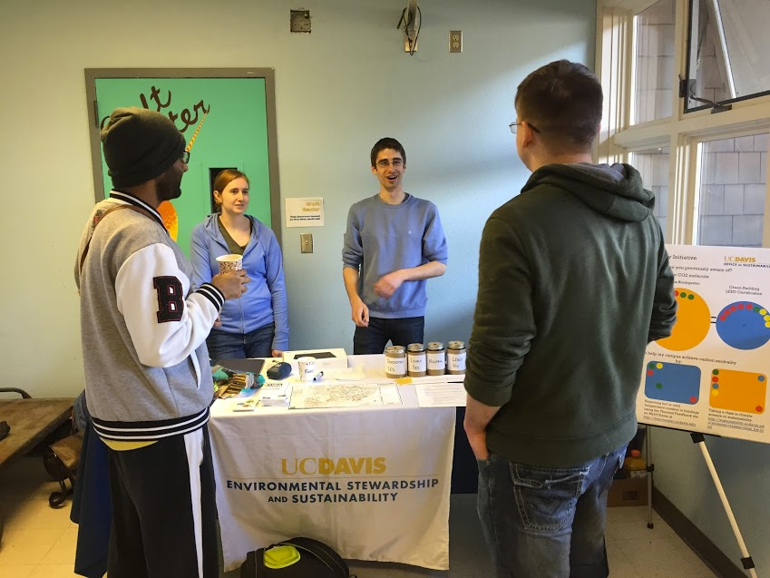
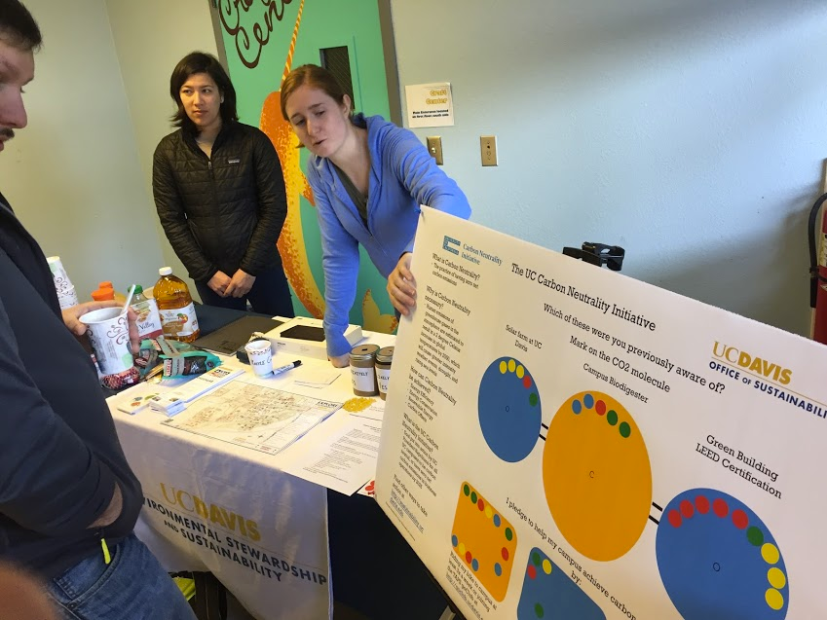
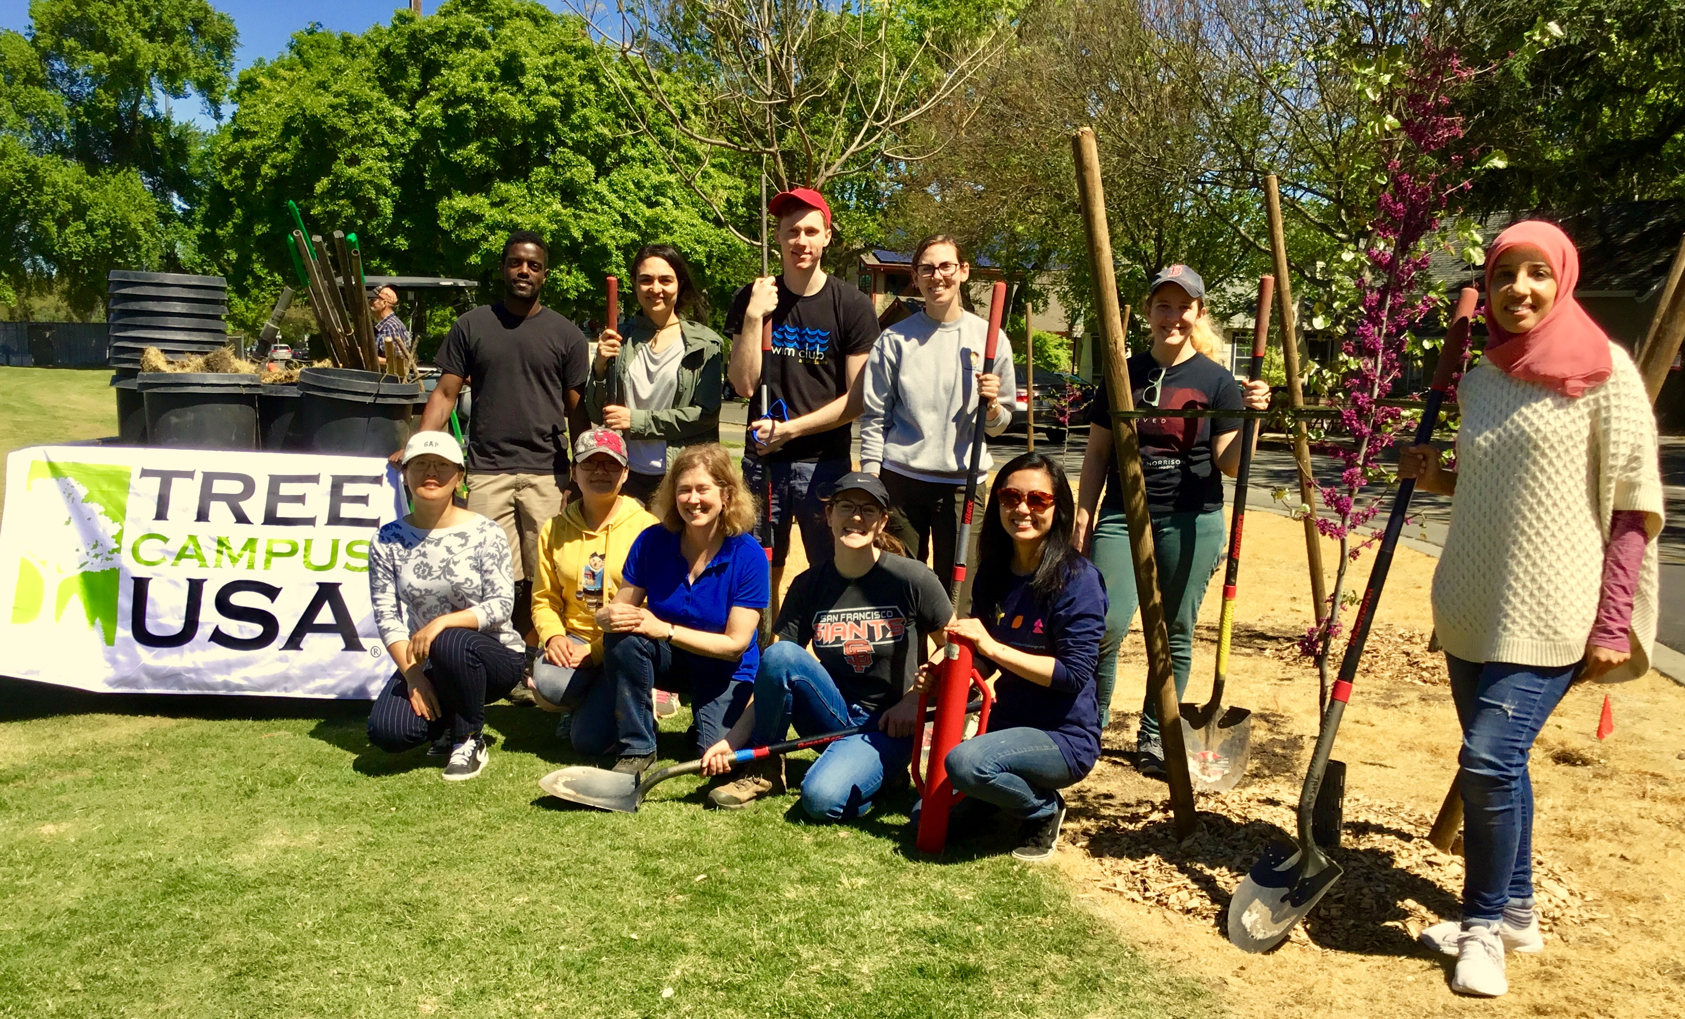
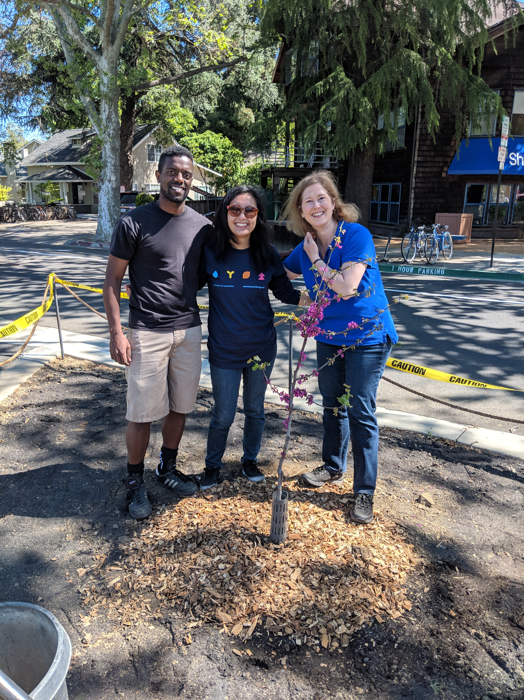
UC Davis Carbon Neutrality Initiative
Student Engagement
Tyler Barzee | Eileen Hollett | Nick Linda | Sheila Perez
Mission
Visual Engagement
In-Person Engagement
The UC Davis Carbon Neutrality Initiative Student Engagement Fellows communicated climate change science and University of California Office of the President goals to undergraduate, graduate, and professional students through partnerships, graphic engagement, in-person engagement, and academic enrichment.
To encourage visual learning, CNI Fellows implemented posters and graphics into their outreach campaign.
UC Davis CNI Reference Materials
Developed interactive posters with laser cut cardboard and magnetic icons as a more evergreen alternative to old posters.
UC Davis CNI Branding
CNI Fellow Nick Linda worked with FOA to create a UC Davis CNI logo that helps to build the Initiative’s brand and recognition around campus.
UC Davis Biodigester Tour
CNI Fellows collaborated with the incoming Energy Graduate Group class to present a tour of the UC Davis Biodigester.
Op-Ed in The Aggie Newspaper
CNI Fellow Sheila Perez wrote an opinion article for The Aggie entitled “UC Davis Climbs Ladder to a Carbon-Free Campus” that was published on-line on May 29th.
Roots on Campus
CNI Fellow Eileen Hollett organized two tree-planting workshops with campus arborists. Students planted trees in prominent campus locations and calculated the amount of carbon that the trees will sequester in their lifetime.
CNI fellows reached diverse student populations by tabling, lecturing, researching, and creating spaces for open conversation about our campus’s efforts to tackle climate change.
Cool Campus Challenge
CNI Fellows engaged in numerous activities to encourage student participation in the Cool Campus Challenge through the month of April. UC Davis finished among the top six campuses.
Coffee Bagel Donut Days
CNI fellows tabled at the popular Graduate Student Association-sponsored Coffee Bagel Donut days on the Davis and Sacramento campuses to target graduate students
Farmer’s Market Tabling
Every Wednesday in Fall and Spring, CNI fellows advertised current projects and aided the Sustainability Office’s Aggie Green Pledge campaign.
Partnerships
CNI fellows collaborated with various on- and off-campus organizations to share our message while aligning our mission with others’. Special effort was devoted to making sure the projects were universal and fostered partnership between fellows instead of focusing on individual projects.
Organizations:
Graduate Student Association
Net Impact
Students for One Health
FARM (Food Animal Reproduction and Medicine Club)
Energy Graduate Group
Undergraduate Research Conference
UCD Coffee House (CoHo)
One Health Symposium
This Symposium is an annual meeting held in collaboration between the Veterinary and Human Medical Schools at UC Davis. CNI Fellows joined the One Health Symposium Planning Committee to create a sustainability panel that explored the environmental implications of health sciences and professions. CNI Fellow Tyler Barzee served as Moderator.
Dining Commons Tabling
During Fall and Spring, CNI Fellow Sheila visited all 3 dining commons and informed UCD students about the Carbon Neutrality Initiative and engaged students with a Spin the Wheel game she created with questions regarding CNI.
Academic Enrichment
Acknowledgments
Appreciation + gratitude for Sue Vang, Camille Kirk, Laura McGowan, UCD GSA, Ruihong Zhang, Net Impact, Students for One Health, FARM, UCD Energy Graduate Group, TGIF, CoHo
Special thanks to the UCOP for funding our work.

